Slide 1
Author: Horstmann
Title: Big Java Late Objects
“This material is reproduced with permission of John Wiley & Sons, Inc.”).
Copyright © 2013 by John Wiley & Sons. All rights reserved.

Slide 2

10
CHAPTER
GRAPHICAL USER INTERFACES
Copyright © 2013 by John Wiley & Sons. All rights reserved.
Slides by Donald W. Smith
TechNeTrain.com
Final Draft
10/30/11

Slide 3
Chapter Goals
To implement simple graphical user interfaces
To add buttons, text fields, and other components to a frame window
To handle events that are generated by buttons
To write programs that display simple drawings
In this chapter, you will learn how to write graphical user-interface applications, process the events that are generated
by button clicks, and process user input,
Copyright © 2013 by John Wiley & Sons. All rights reserved.
Page <number>

Slide 4
Contents
Frame Windows
Events and Event Handling
Processing Text Input
Creating Drawings
Copyright © 2013 by John Wiley & Sons. All rights reserved.
Page <number>

Slide 5
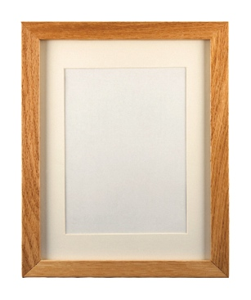
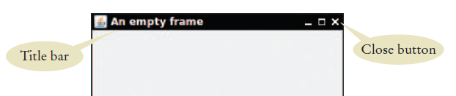
10.1 Frame Windows
Java provides classes to create graphical applications that can run on any major graphical user interface
  A graphical application shows information inside a frame: a window with a title bar
Java’s JFrame class allows you to display a frame
  It is part of the javax.swing package
Copyright © 2013 by John Wiley & Sons. All rights reserved.
Page <number>

Slide 6
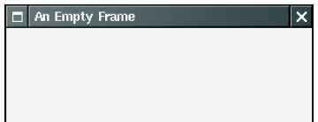
The JFrame Class
Five steps to displaying a frame:
  Construct an object of the JFrame class
  Set the size of the frame
  Set the title of the frame
  Set the “default close operation”
  Make it visible
JFrame frame = new JFrame();
frame.setSize(300,400);
frame.setTitle(“An Empty Frame”);
frame.setDefaultCloseOperation(JFrame.EXIT_ON_CLOSE);
frame.setVisible (true);
Copyright © 2013 by John Wiley & Sons. All rights reserved.
Page <number>

Slide 7
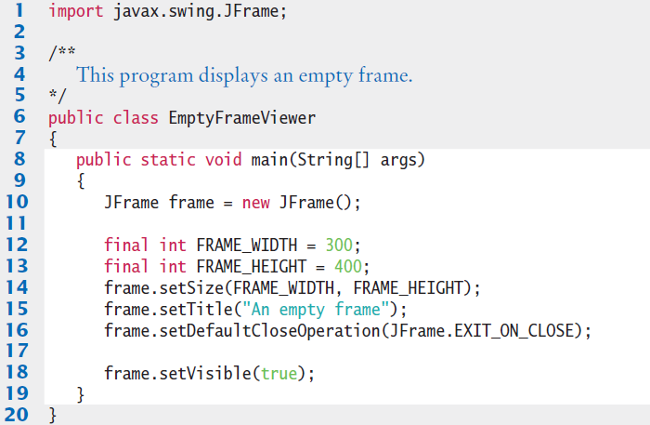
EmptyFrameViewer.java
Your JVM (Java Virtual Machine does all of the work of displaying the frame on your GUI
  This application is portable to all supported GUIs!
You are using the java Swing library
Copyright © 2013 by John Wiley & Sons. All rights reserved.
Page <number>

Slide 8
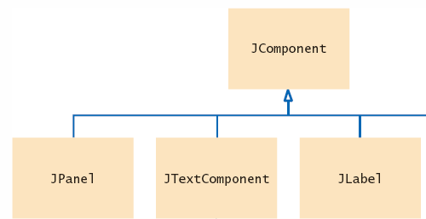
Adding Components
You cannot draw directly on a JFrame object
Instead, construct an object and add it to the frame
  A few examples objects to add are:
    JComponent
    Jpanel
    JTextComponent
    JLabel
public class RectangleComponent extends JComponent
{
public void paintComponent(Graphics g)
{
// Drawing instructions go here
}
}
Extend the JComponent Class and override its paintComponent method
Copyright © 2013 by John Wiley & Sons. All rights reserved.
Page <number>

Slide 9
Adding Panels
If you have more than one component, put them into a panel (a container for other user-interface components), and then add the panel to the frame:
  First Create the components
  Then Add them to the panel
JButton button = new JButton("Click me!");
JLabel label = new JLabel("Hello, World!");
JPanel panel = new JPanel();
panel.add(button);
panel.add(label);
frame.add(panel);
Use a JPanel to group multiple
user-interface components together.
Add the panel to the frame
Copyright © 2013 by John Wiley & Sons. All rights reserved.
Page <number>

Slide 10
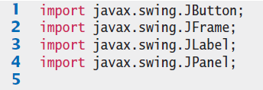
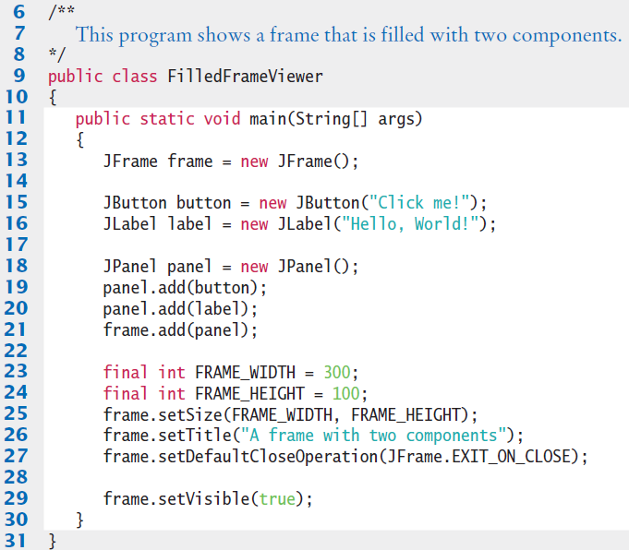
FilledFrameViewer.java
Copyright © 2013 by John Wiley & Sons. All rights reserved.
Page <number>

Slide 11
Using Inheritance to Customize Frames
For complex frames:
  Design a subclass of JFrame
  Store the components as instance variables
  Initialize them in the constructor of your subclass.
public class FilledFrame extends JFrame
{
private JButton button;
private JLabel label;
private static final int FRAME_WIDTH = 300;
private static final int FRAME_HEIGHT = 100;
public FilledFrame()
{
createComponents();
setSize(FRAME_WIDTH, FRAME_HEIGHT);
}
}
Components are instance variables
Initialize and add them in the constructor of your subclass with a helper method
Copyright © 2013 by John Wiley & Sons. All rights reserved.
Page <number>

Slide 12
Using Inheritance to Customize Frames
Then instantiate the customized frame from the main method
public class FilledFrameViewer2
{
public static void main(String[] args)
{
JFrame frame = new FilledFrame();
frame.setTitle("A frame with two components");
frame.setDefaultCloseOperation(JFrame.EXIT_ON_CLOSE);
frame.setVisible(true);
}
}
Copyright © 2013 by John Wiley & Sons. All rights reserved.
Page <number>

Slide 13

Special Topic 10.1
Adding the main Method to the Frame Class
  Some programmers prefer this technique
public class FilledFrame extends JFrame
{
. . .
public static void main(String[] args)
{
JFrame frame = new FilledFrame();
frame.setTitle("A frame with two components");
frame.setDefaultCloseOperation(JFrame.EXIT_ON_CLOSE);
frame.setVisible(true);
}
public FilledFrame()
{
createComponents();
setSize(FRAME_WIDTH, FRAME_HEIGHT);
}
. . .
}
Once main has instantiated the FilledFrame, non-static instance variables and methods can be used.
Copyright © 2013 by John Wiley & Sons. All rights reserved.
Page <number>

Slide 14
10.2 Events and Event Handling
In a modern graphical user interface program, the user controls the program through the mouse and keyboard.
The user can enter information into text fields, pull down menus, click buttons, and drag scroll bars in any order.
  The program must react to the user commands
  The program can choose to receive and handle events such as “mouse move” or a button push “action event”
Copyright © 2013 by John Wiley & Sons. All rights reserved.
Page <number>

Slide 15
Events and Action Listeners
Programs must indicate which events it wants to receive
It does so by installing event listener objects
  An event listener object belongs to a class that you declare
  The methods of your event listener classes contain the instructions that you want to have executed when the events occur
To install a listener, you need to know the event source
You add an event listener object to selected event sources:
  Examples: OK Button clicked, Cancel Button clicked, Menu Choice..
Whenever the event occurs, the event source calls the appropriate methods of all attached event listeners
Copyright © 2013 by John Wiley & Sons. All rights reserved.
Page <number>

Slide 16
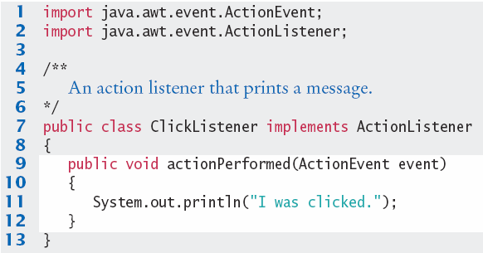
Example ActionListener
The ActionListener interface has one method:
ClickListener class implements the ActionListener interface
public interface ActionListener
{
void actionPerformed(ActionEvent event);
}
We can ignore the event parameter – it has information such as when the event occurred
Copyright © 2013 by John Wiley & Sons. All rights reserved.
Page <number>

Slide 17
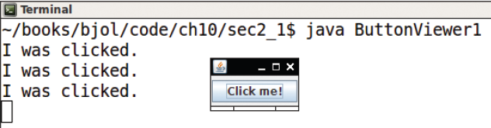
Registering ActionListener
A ClickListener object must be created, and then ‘registered’ (added) to a specific event source
Now whenever the button object is clicked, it will call listener.ActionPerformed, passing it the event as a parameter
ActionListener listener = new ClickListener();
button.addActionListener(listener);
Copyright © 2013 by John Wiley & Sons. All rights reserved.
Page <number>

Slide 18
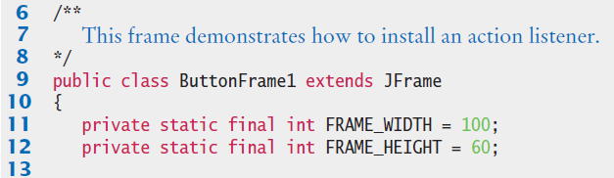
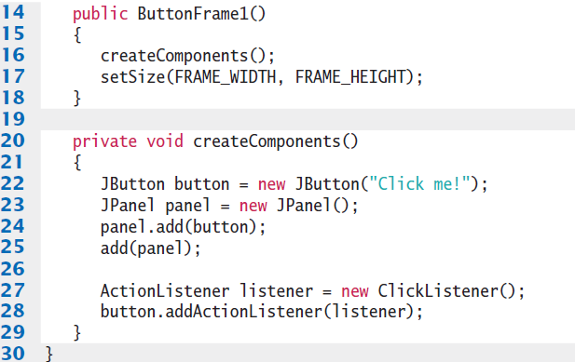
ButtonFrame1.java
Creates and adds a JButton to the frame
Tells the button to ‘call us back’ when an event occurs.
Copyright © 2013 by John Wiley & Sons. All rights reserved.
Page <number>

Slide 19
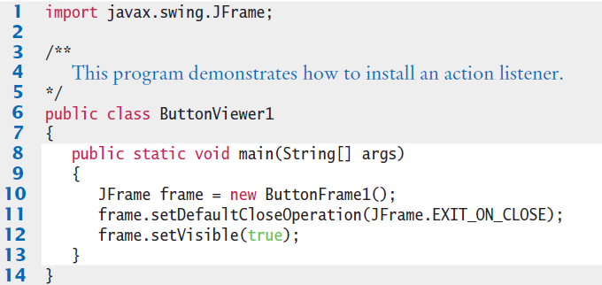
ButtonViewer1.java
No changes required to the main to implement an event handler
Copyright © 2013 by John Wiley & Sons. All rights reserved.
Page <number>

Slide 20
Inner Classes for Listeners
In the preceding section, you saw how the code that is executed when a button is clicked is placed into a listener class.
Inner Classes are often used for ActionListeners
An Inner class is a class that is declared inside another class
  It may be declared inside or outside a method of the class
Why inner classes? Two reasons:
  1) It places the trivial listener class exactly where it is needed, without cluttering up the remainder of the project
  2) Their methods can access variables that are declared in surrounding blocks.
  In this regard, inner classes declared inside methods behave similarly to nested blocks
Copyright © 2013 by John Wiley & Sons. All rights reserved.
Page <number>

Slide 21
Example Inner Class Listener
The inner class ClickListener declared inside the class ButtonFrame2 can access local variables inside the surrounding scope
public class ButtonFrame2 extends JFrame
{
private JButton button;
private JLabel label;
. . .
class ClickListener implements ActionListener
{
public void actionPerformed(ActionEvent event)
{
label.setText("I was clicked");
}
}
. . .
}
Outer
Block
Inner
Block
Can easily access methods of the private instance of a label object.
Copyright © 2013 by John Wiley & Sons. All rights reserved.
Page <number>

Slide 22
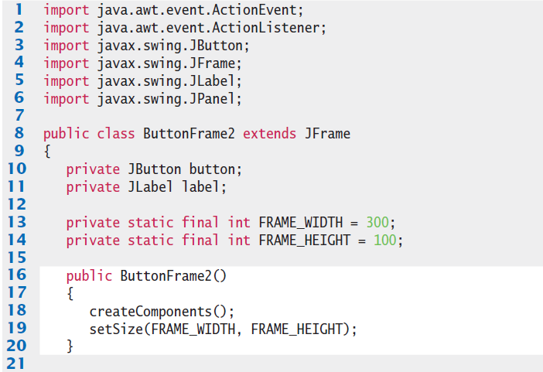
ButtonFrame2.java (1)
Copyright © 2013 by John Wiley & Sons. All rights reserved.
Page <number>

Slide 23
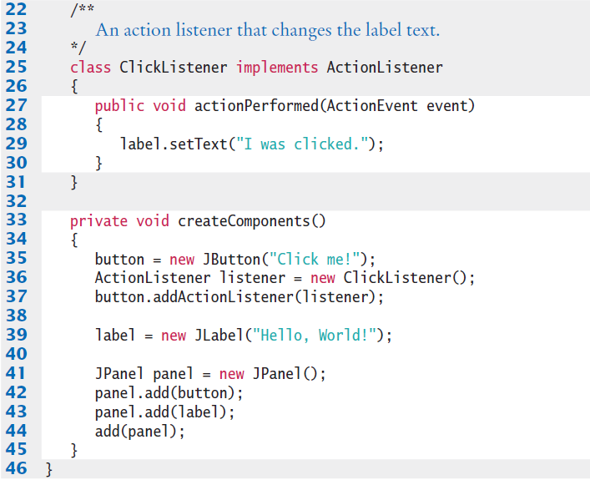
ButtonFrame2.java (2)
Changes label from “Hello World!” to “I was clicked.”:
Copyright © 2013 by John Wiley & Sons. All rights reserved.
Page <number>

Slide 24
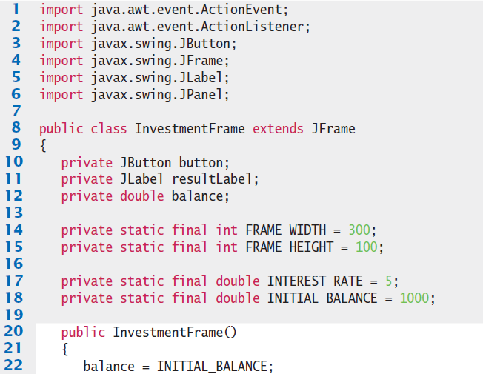

InvestmentFrame.java (1)

Slide 25
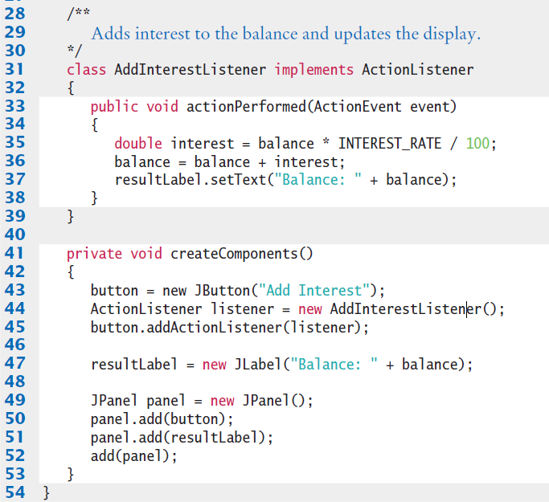
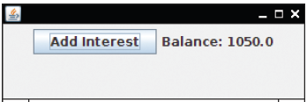
InvestmentFrame.java (2)
User clicks the button four times for output:

Slide 26

Common Error 10.1
Modifying Parameter Types in the Implementing Method
  When you implement an interface, you must declare each method exactly as it is specified in the interface.
  Accidentally making small changes to the parameter types is a common error: For example:
public interface ActionListener
{
void actionPerformed(ActionEvent event);
}
class MyListener implements ActionListener
{
public void actionPerformed()
// Oops . . . forgot ActionEvent parameter
{ . . . }
}
Copyright © 2013 by John Wiley & Sons. All rights reserved.
Page <number>

Slide 27
Common Error 10.2
Forgetting to Attach a Listener
  If you run your program and find that your buttons seem to be dead, double-check that you attached the button listener.
  The same holds for other user-interface components. It is a surprisingly common error to program the listener class and the event handler action without actually attaching the listener to the event source.
...
ActionListener listener = new ClickListener();
button.addActionListener(listener);
Copyright © 2013 by John Wiley & Sons. All rights reserved.
Page <number>

Slide 28

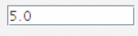
10.3 Processing Text Input
Dialog boxes allows for user input… but
  Popping up a separate dialog box for each input is not a natural user interface
Most graphical programs collect text input through text fields
  The JTextField class provides a text field
    When you construct a text field, supply the width:
      The approximate number of characters that you expect
      If the user exceeds this number, text will ‘scroll’ left
final int FIELD_WIDTH = 10;
final JTextField rateField = new JTextField(FIELD_WIDTH);
Copyright © 2013 by John Wiley & Sons. All rights reserved.
Page <number>

Slide 29


Add a Label and a Button
A Label helps the user know what you want
  Normally to the left of a textbox
A Button with an actionPerformed method can be used to read the text from the textbox with the getText method
  Note that getText returns a String, and must be converted to a numeric value if it will be used in calculations
JLabel rateLabel = new JLabel("Interest Rate: ");
double rate = Double.parseDouble(rateField.getText());
double interest = account.getBalance() * rate / 100;
account.deposit(interest);
resultLabel.setText("balance: " + account.getBalance());
Copyright © 2013 by John Wiley & Sons. All rights reserved.
Page <number>

Slide 30
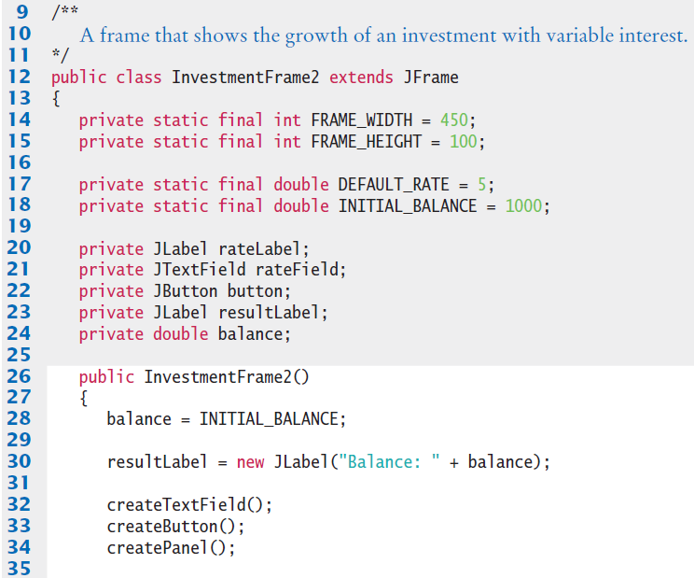
InvestmentFrame2.java
Use this as a framework for GUIs that do calculations
Place input components into the frame
Copyright © 2013 by John Wiley & Sons. All rights reserved.
Page <number>

Slide 31
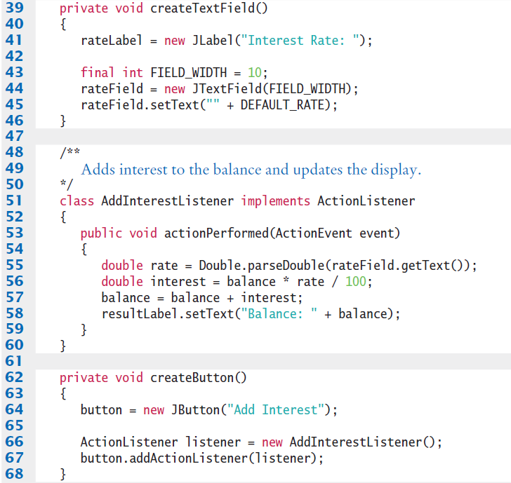
InvestmentFrame2.java (2)
Do calculations in ActionPerformed method
Keep the code for the listener and the object (Button) in the same area
Copyright © 2013 by John Wiley & Sons. All rights reserved.
Page <number>

Slide 32
Text Areas
Create multi-line text areas with a JTextArea object
  Set the size in rows and columns
  Use the setText method to set the text of a text field or text area
final int ROWS = 10;
final int COLUMNS = 30;
JTextArea textArea = new JTextArea(ROWS, COLUMNS);
textArea.setText(“Account Balance”);
Copyright © 2013 by John Wiley & Sons. All rights reserved.
Page <number>

Slide 33
Text Areas
  The append method adds text to the end of a text area
    Use newline characters to separate lines
  Use the setEditable method to control user input
textArea.append(account.getBalance() + "\n");
textArea.setEditable(false);
Copyright © 2013 by John Wiley & Sons. All rights reserved.
Page <number>

Slide 34
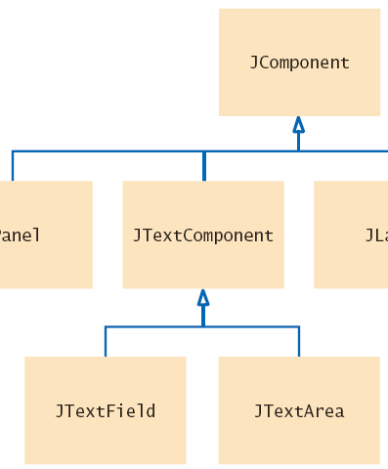
JTextField and JTextArea
JTextField and JTextArea inherit from JTextComponent:
  setText
  setEditable
Copyright © 2013 by John Wiley & Sons. All rights reserved.
Page <number>

Slide 35
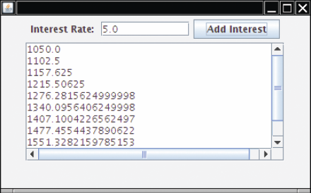
JTextField and JTextArea
The append method is declared in the JTextArea class
To add scroll bars, use JScrollPane:
JScrollPane scrollPane = new JScrollPane(textArea);
Copyright © 2013 by John Wiley & Sons. All rights reserved.
Page <number>

Slide 36
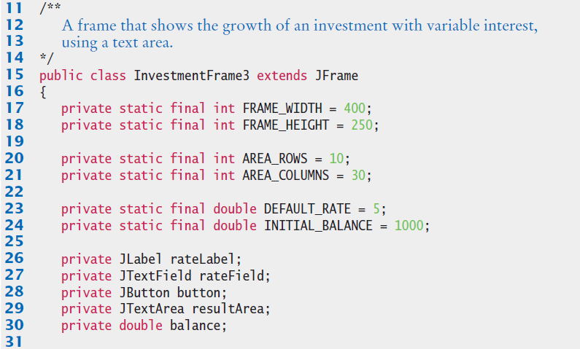
InvestmentFrame3.java (1)
Declare the components to be used
Copyright © 2013 by John Wiley & Sons. All rights reserved.
Page <number>

Slide 37

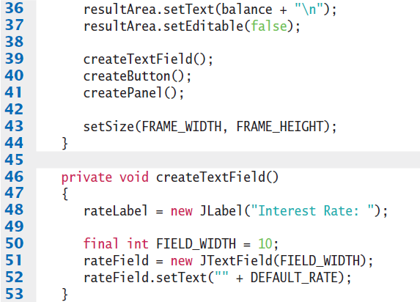
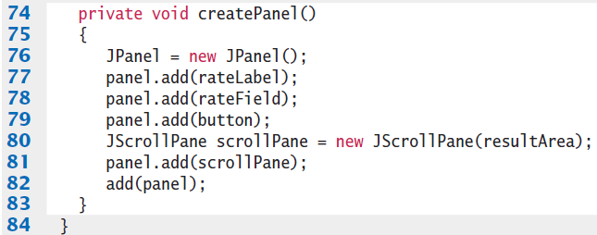
InvestmentFrame.java (2)
Constructor calls methods to create the components
Copyright © 2013 by John Wiley & Sons. All rights reserved.
Page <number>

Slide 38
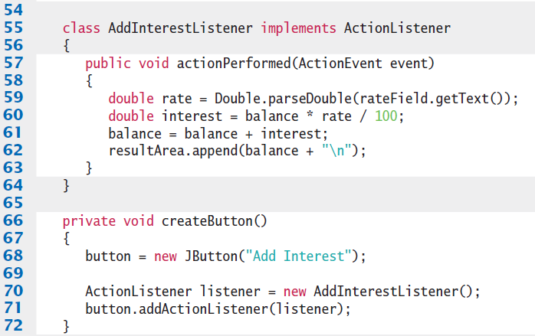
InvestmentFrame.java (3)
The listener class and associated createButton method
Copyright © 2013 by John Wiley & Sons. All rights reserved.
Page <number>

Slide 39
10.4 Creating Drawings
You cannot draw directly on a JFrame object
Instead, construct an object and add it to the frame
  A few examples objects to draw on are:
    JComponent
    Jpanel
    JTextComponent
    JLabel
public class chartComponent extends JComponent
{
public void paintComponent(Graphics g)
{
// Drawing instructions go here
}
}
Extend the JComponent Class and override its paintComponent method

Slide 40
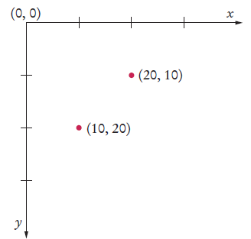
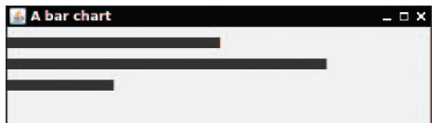
The paintComponent method
The paintComponent method is called automatically when:
  The component is shown for the first time
  Every time the window is resized, or after being hidden
public class chartComponent extends JComponent
{
public void paintComponent(Graphics g)
{
g.fillRect(0, 10, 200, 10);
g.fillRect(0, 30, 300, 10);
g.fillRect(0, 50, 100, 10);
}
}

Slide 41
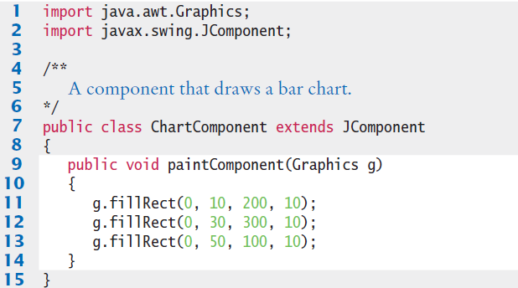
ChartComponent.java
The Graphics class is part of the java.awt package
We now have a JComponent object that can be added to a Jframe
Copyright © 2013 by John Wiley & Sons. All rights reserved.
Page <number>

Slide 42
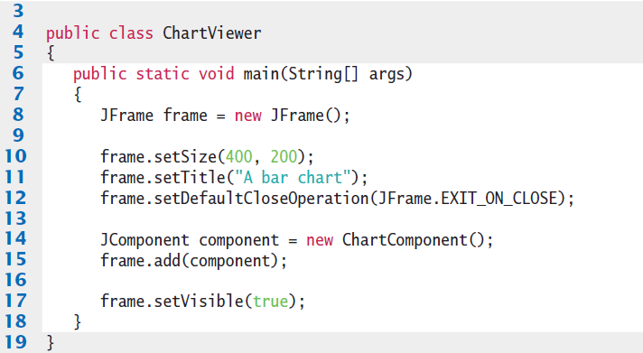
ChartViewer.java
Adding the component to the frame
Copyright © 2013 by John Wiley & Sons. All rights reserved.
Page <number>

Slide 43
The Graphics parameter
The paintComponent method receives an object of type Graphics
  The Graphics object stores the graphics state
    The current color, font, etc., that are used for drawing operations
  The Graphics2D class extends the Graphics class
    Provides more powerful methods to draw 2D objects
    When using Swing, the Graphics parameter is actually of the Graphics2D type, so we need to cast it to Graphics2D to use it
public class RectangleComponent extends JComponent
{
public void paintComponent(Graphics g)
{
Graphics2D g2 = (Graphics2D) g;
}
}
Now you are ready to draw more complex shapes!
Copyright © 2013 by John Wiley & Sons. All rights reserved.
Page <number>

Slide 44
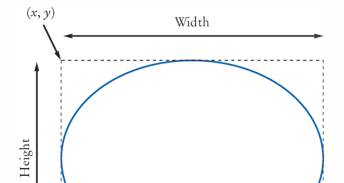
Ovals, Lines, Text, and Color
Ellipses are drawn inside a bounding box in the same way that you specify a rectangle:
  Provide the x and y coordinates of the top-left corner
  Provide the width and height of the bounding box
  Use the Graphics class drawOval method to create an ellipse
  Use drawLine between
  two points:
g.drawOval(x, y, width, height);
g.drawLine(x1, y1, x1, y2);
Copyright © 2013 by John Wiley & Sons. All rights reserved.
Page <number>

Slide 45
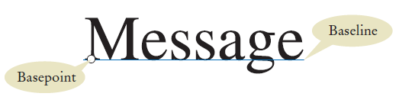
Drawing Text
Use the drawString method of the Graphics class to draw a string anywhere in a window
  Specify the String
  Specify the Basepoint (x and y coordinates)
  The Baseline is the y coordinate of the Basepoint
g2.drawString("Message", 50, 100);
Copyright © 2013 by John Wiley & Sons. All rights reserved.
Page <number>

Slide 46
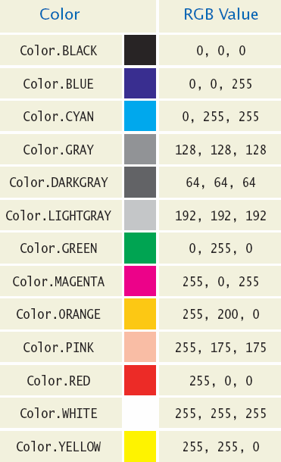
Using Color
All shapes and strings are drawn with a black pen and white fill by default
To change the color, call setColor with an object of type Color
  Java uses the RGB color model
  You can use predefined colors, or create your own
g.setColor(Color.YELLOW);
g.fillOval(350, 25, 35, 20);
All shapes drawn after setColor will use it
Copyright © 2013 by John Wiley & Sons. All rights reserved.
Page <number>

Slide 47
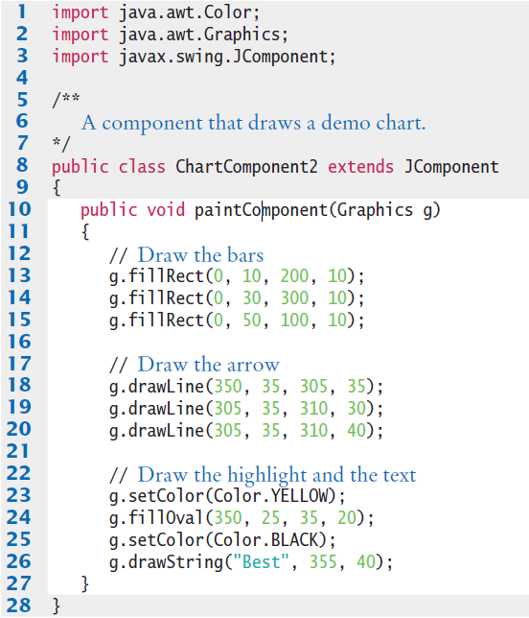
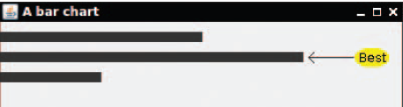
ChartComponent2.java
Copyright © 2013 by John Wiley & Sons. All rights reserved.
Page <number>

Slide 48
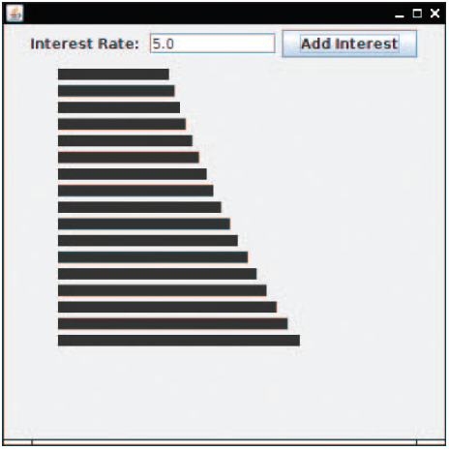
Application: Investment Growth
Input the interest rate
Click on the Add Interest button to add bars to the graph
Maintains a list of values to redraw all bars each time
Copyright © 2013 by John Wiley & Sons. All rights reserved.
Page <number>

Slide 49
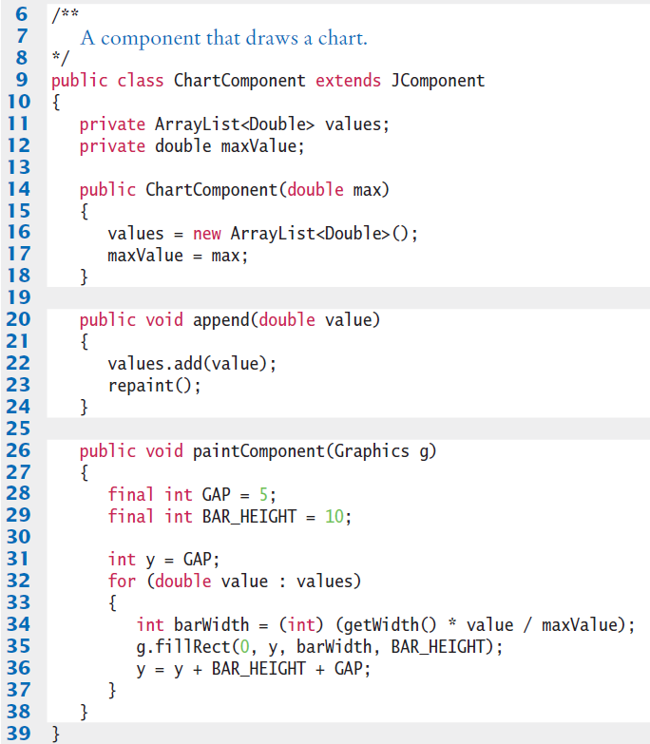
ChartComponent.java
Use an ArrayList to hold bar values
Add a new value to Arraylist
Paint bars in a loop
Copyright © 2013 by John Wiley & Sons. All rights reserved.
Page <number>

Slide 50
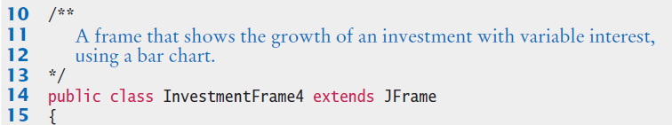
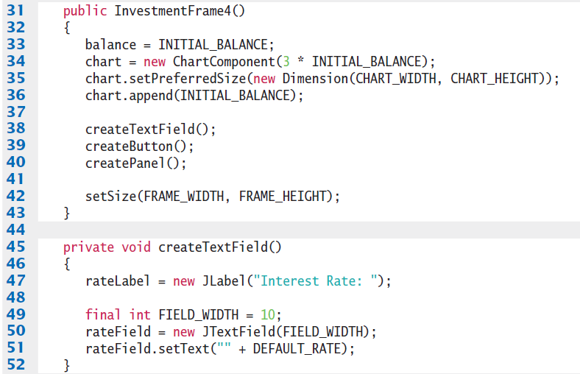
InvestmentFrame4.java (1)
Instantiates and initializes ChartComponent
Use helper methods to create components
Copyright © 2013 by John Wiley & Sons. All rights reserved.
Page <number>

Slide 51
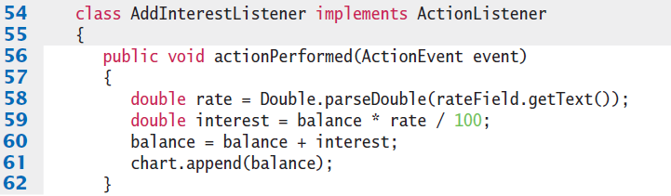
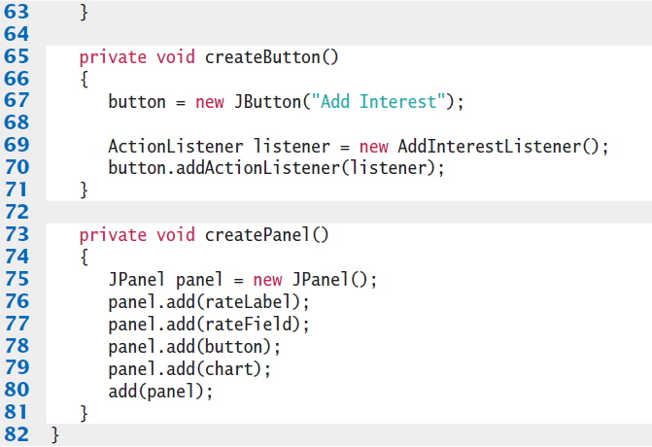
InvestmentFrame4.java (2)
Listener and Button setup
Copyright © 2013 by John Wiley & Sons. All rights reserved.
Page <number>

Slide 52
Common Error 10.3
Forgetting to Repaint
  When you change the data in a painted component, the component is not automatically painted with the new data.
  You must call the repaint method of the component
  The best place to call repaint is in the method of your component that modifies the data values:
void changeData(. . .)
{
// Update data values
repaint();
}
Copyright © 2013 by John Wiley & Sons. All rights reserved.
Page <number>

Slide 53
Common Error 10.4
By default, Components have zero width and height
  You must be careful when you add a painted component, such as a component displaying a chart, to a panel
  The default size for a JComponent is 0 by 0 pixels, and the component will not be visible.
  The remedy is to call the setPreferredSize method:
chart.setPreferredSize(new Dimension(CHART_WIDTH, CHART_HEIGHT));
Copyright © 2013 by John Wiley & Sons. All rights reserved.
Page <number>

Slide 54
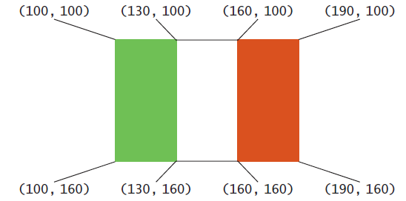
Steps to Drawing Shapes
1) Determine the shapes you need for your drawing.
  Squares and rectangles
  Circles and ellipses
  Lines and Text
2) Find the coordinates of each shape.
  For rectangles and ellipses, you need the top-left corner, width, and height of the bounding box.
  For lines, you need the x- and y-positions of the starting point and the end point.
  For text, you need the x- and y-position of the basepoint
Copyright © 2013 by John Wiley & Sons. All rights reserved.
Page <number>

Slide 55
Steps to Drawing Shapes
3) Write Java statements to draw the shapes.
  If possible, use variables and ‘offsets’ for the locations and sizes
g.setColor(Color.GREEN);
g.fillRect(100, 100, 30, 60);
g.setColor(Color.RED);
g.fillRect(160, 100, 30, 60);
10.4 Creating Drawings 499
g.setColor(Color.BLACK);
g.drawLine(130, 100, 160, 100);
g.drawLine(130, 160, 160, 160);
g.fillRect(xLeft, yTop, width / 3, width * 2 / 3);
. . .
g.fillRect(xLeft + 2 * width / 3, yTop, width / 3, width * 2 / 3);
. . .
g.drawLine(xLeft + width / 3, yTop, xLeft + width * 2 / 3, yTop);
Copyright © 2013 by John Wiley & Sons. All rights reserved.
Page <number>

Slide 56
Steps to Drawing Shapes
4) Consider using methods or classes for repetitive steps.
5) Place the drawing instructions in the paintComponent method.
If the drawing is complex, use call methods of Step 4
void drawItalianFlag(Graphics g, int xLeft, int yTop, int width)
{
// Draw a flag at the given location and size
}
public class ItalianFlagComponent extends JComponent
{
public void paintComponent(Graphics g)
{
// Drawing instructions
}
}
Copyright © 2013 by John Wiley & Sons. All rights reserved.
Page <number>

Slide 57
Steps to Drawing Shapes
6) Write the viewer class.
Provide a viewer class, with a main method in which you construct a frame, add your component, and make your frame visible.
public class ItalianFlagViewer
{
public static void main(String[] args)
{
JFrame frame = new JFrame();
frame.setSize(300, 400);
frame.setDefaultCloseOperation(JFrame.EXIT_ON_CLOSE);
JComponent component = new ItalianFlagComponent();
frame.add(component);
frame.setVisible(true);
}
}
Copyright © 2013 by John Wiley & Sons. All rights reserved.
Page <number>

Slide 58
Summary: Frames and Components
To show a frame, construct a JFrame object, set its size, and make it visible.
Use a JPanel to group multiple user-interface components together.
Declare a JFrame subclass for a complex frame.
Copyright © 2013 by John Wiley & Sons. All rights reserved.
Page <number>

Slide 59
Summary: Events and Handlers
User-interface events include key presses, mouse moves, button clicks, menu selections, and so on.
An event listener belongs to a class created by the application programmer.
  Its methods describe the actions to be taken when an event occurs.
  Event sources report on events. When an event occurs, the event source notifies all event listeners.
Attach an ActionListener to each button so that your program can react to button clicks.
Methods of an inner class can access variables from the surrounding class.
Copyright © 2013 by John Wiley & Sons. All rights reserved.
Page <number>

Slide 60
Summary: TextFields and TextAreas
Use JTextField components to provide space for user input.
  Place a JLabel next to each text field
Use a JTextArea to show multiple lines of text
  You can add scroll bars to any component with a JScrollPane
You can add scroll bars to any component with a JScrollPane.
Copyright © 2013 by John Wiley & Sons. All rights reserved.
Page <number>

Slide 61
Summary: Simple Shapes
In order to display a drawing, provide a class that extends the JComponent class.
Place drawing instructions inside the paintComponent method.
  That method is called whenever the component needs to be repainted.
The Graphics class has methods to draw rectangles and other shapes.
  Use drawRect, drawOval, and drawLine to draw geometric shapes.
  The drawString method draws a string, starting at its basepoint.
Copyright © 2013 by John Wiley & Sons. All rights reserved.
Page <number>

Slide 62
Summary: Color and repaint
When you set a new color in the graphics context, it is used for subsequent drawing operations.
Call the repaint method whenever the state of a painted component changes.
When placing a painted component into a panel, you need to specify its preferred size.
Copyright © 2013 by John Wiley & Sons. All rights reserved.
Page <number>

